Slide 1
Nyc restaurant cleanliness
Anh Vu Nguyen, Cody Couture, Anh Nguyen

Slide 2
New York city & cuisine
Diverse culture
Several authorities consider New York Pizza to be best in the world
Many foods such as pasta primavera and eggs Benedict, and The ice cream cone were all invented in New York City
Millions of tourists Visit each year
But how clean are restaurants in NYC?
Notes:
Cody

Slide 3
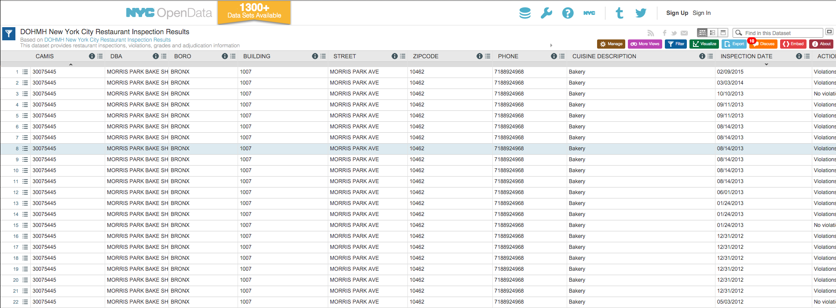
Data collections
Data are collected from NYC socrata Open data portal.
The Whole dataset was loaded into Rstudio (484,743 rows as of nov 14, 2015)
Notes:
Vu

Slide 4
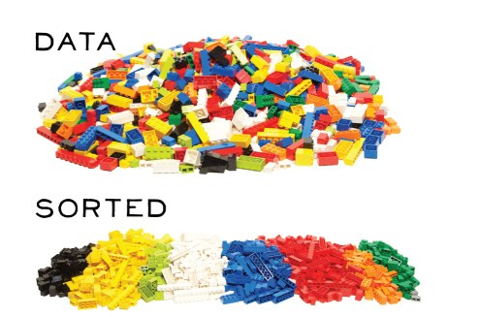
Data Wrangling
Only consider A restaurant’s most recent inspection
Take out inspections without a grade
Were Rodents or Roaches Sighted During the most recent inspection?
Added demographic data associated with Restaurant zip code
Only consider specific cuisines instead of looking at all cuisines
Cleaned Dataset: 11,530 Rows of observation
Notes:
Vu

Slide 5
Exploratory graphs

Slide 6
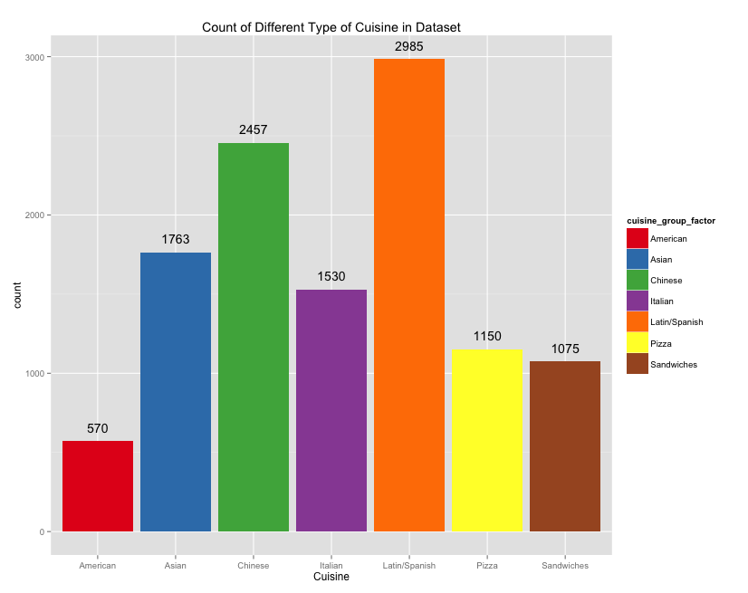
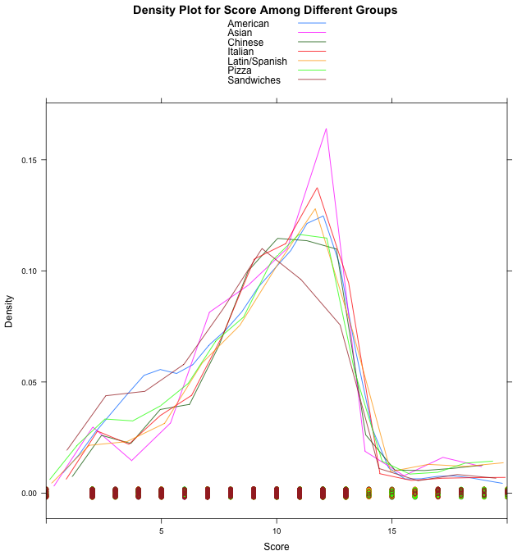
Notes:
Anh

Slide 7
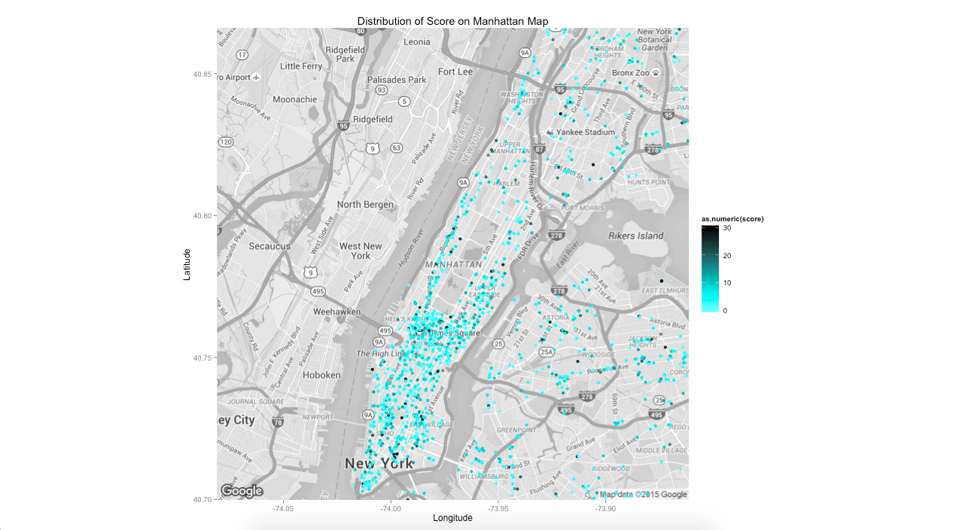
Notes:
Cody

Slide 8
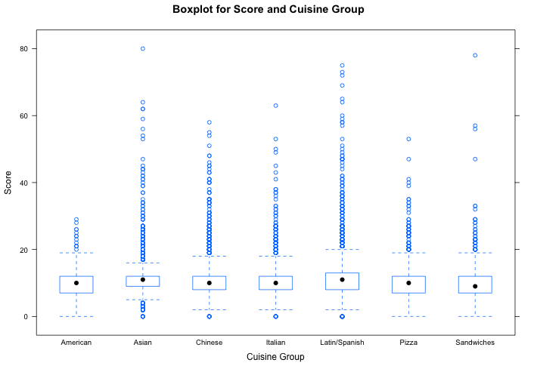
Phayul Restaurant
Notes:
Cody

Slide 9
Our Questions
Do Chinese restaurants Actually Score worse than other cuisines?
Are Rodents & roaches ACTUALLY a problem in New York city?
Notes:
Cody

Slide 10
Confident interval for mean of Chinese restaurant’s Score
One sample t-test
95% Confident interval
[11.04, 11.54]
13 is the cutoff between grade a & b → we’re 95% confident that on average a Chinese restaurant score between 11 and 11.5, which is equivalent to an a.
Notes:
Anh

Slide 11
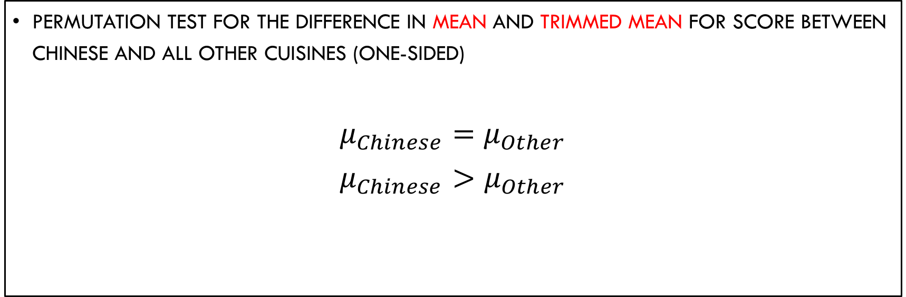
ARE Chinese restaurants that bad?
Permutation test for the difference in mean and trimmed mean for score between Chinese and all other cuisines (One-sided)
$$μ_{Chinese}=μ_{Other}$$
$$μ_{Chinese}>μ_{Other}$$
Notes:
Anh

Slide 12
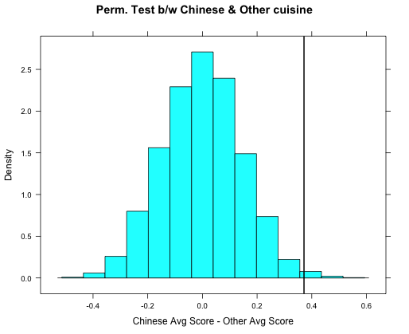
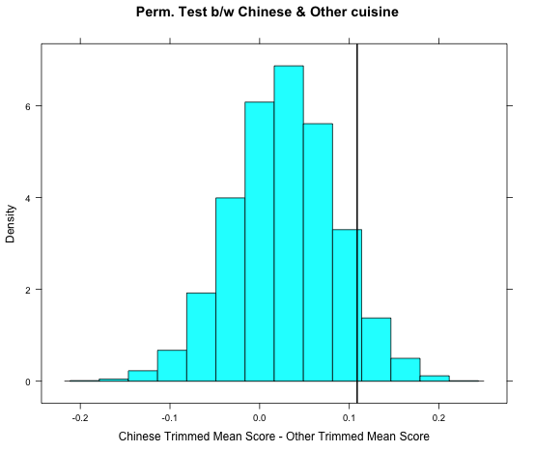
P-value: 0.0066
P-value: 0.0806
Notes:
Anh

Slide 13
overwhelming evidence of Chinese Restaurant’s score being higher than that of other cuisines
trimmed mean’s P-value > mean’s P-Value
When high scoring Chinese restaurants are removed, the difference in score is not as extreme
Chinese Restaurants might not be as clean as other cuisines, but some of this is driven by outliers
Notes:
Anh
Possible Type II error

Slide 14
ARE Chinese restaurants THE WORST?
T-test for difference in means between Chinese and Asian Restaurants
95% Confident interval
[-0.73, 0.082]
Notes:
Vu
We are 95% confident that the average Chinese restaurants score are between -0.7 points lower and 0.082 points higher than that of the average Asian restaurants score. The interval passes zero.
We have the assumptions for this:
1. Large enough N (we have more than thousands observations)
2. Independence within group and among groups

Slide 15
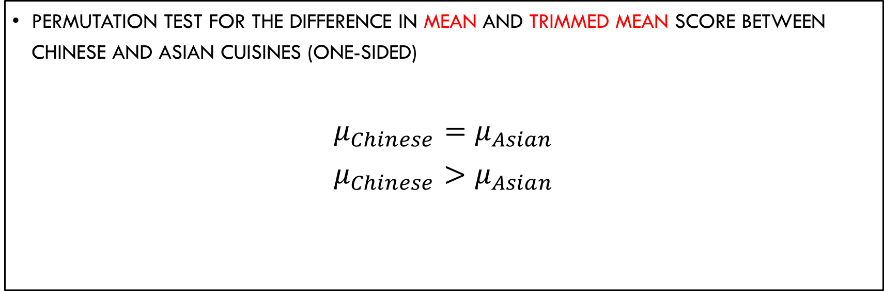
ARE Chinese restaurants THE WORST?
Permutation test for the difference in mean and trimmed mean Score between Chinese and Asian cuisines (One-sided)
$$μ_{Chinese}=μ_{Asian}$$
$$μ_{Chinese}>μ_{Asian}$$
Notes:
Vu

Slide 16
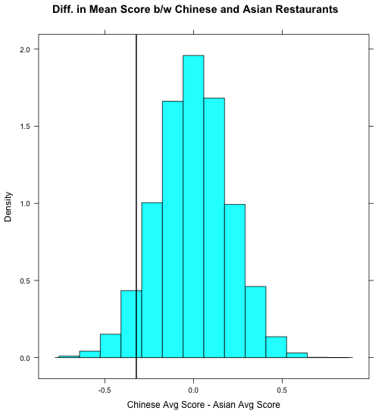
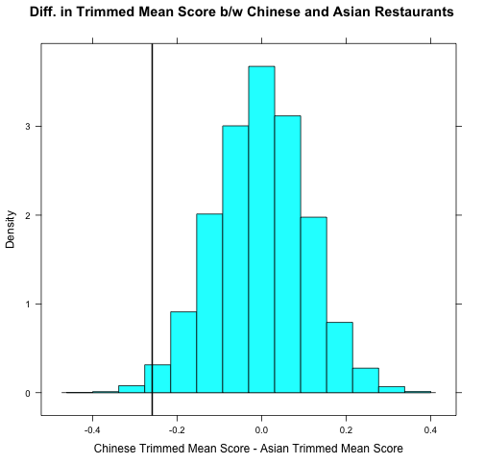
P-value: 0.9444
P-value: 0.9904
Notes:
Vu
1 - 0.944 = 0.056
1- 0.9904 = 0.0096

Slide 17
no evidence of Chinese cuisine’s Average score being higher than that of Asian. Instead, it seems the other way around
trimmed mean’s p-value > mean’s P-Value
AGAIN, AVERAGE SCORE WERE DRIVEN BY OUTLIERS IN CHINESE RESTAURANTS
Asian restaurants are likely worse than Chinese restaurants in Score
Notes:
Vu
Possible Type I Error

Slide 18
Linear regression
Sqrt(Score) ~ Median income
SQRT(Score) = 3.24 – 6.57 x 10^(-7) x Median Income
R-Squared: 0%
Aic = 29335.85
Variable | P-value
Median Income | 0.0322
Notes:
Anh

Slide 19
Linear regression
Sqrt(Score) ~ Cuisine + Median income
Sqrt(Score) = 3 + 0.3069 x Asian + 0.2550 x Chinese + 0.1927 x Italian + 0.2863 x Latin/Spanish + 0.1269 x pizza – 0.067 x Sandwiches – 1.421 x 10^(-7) x Median Income
R-squared: 1.7%
Aic = 29514
Variable | P-value
Asian | 0
Chinese | 0
Italian | 0
Latin/Spanish | 0
Pizza | 0.00522
Sandwiches | 0.14556
Median Income | 0.66422
Notes:
Anh
- American restaurants is the reference group
The relationship between score and income might be better explained when we take cuisine type into consideration
The significance of income on score can be explained by the fact that cleaner cuisines, such as American restaurants, are more likely to be opened in higher income zip codes. Both of the variables (income and better rating) are linked with higher chance of getting american cuisine.
Essentially, it looks like income is positively related to score, but what seems to be the case is that income is related to cuisine and cuisine is related to score (i.e. American restaurants tend to be opened in wealthy areas and Latin/Asian restaurants are more likely to be open in lower income areas. There isn’t a significant difference in an Asian restaurant in a high income area vs. a low income area just a difference in Asian and Ameriacn)

Slide 20

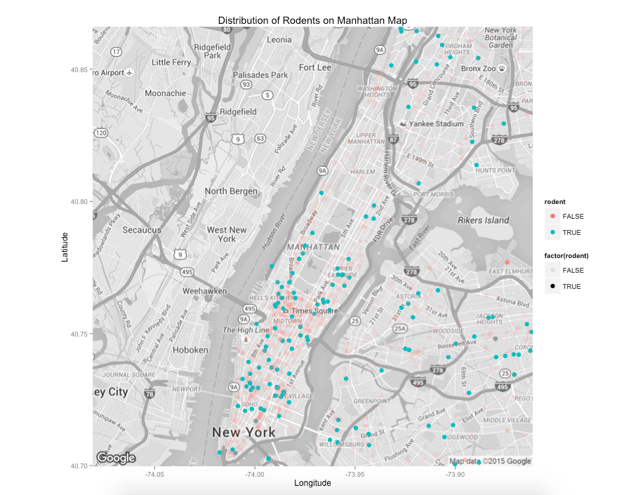
Pest problem in NYC
Notes:
Cody

Slide 21
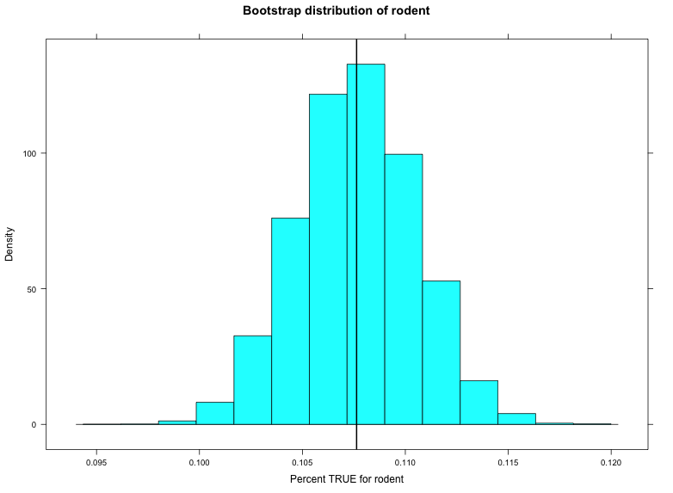
Notes:
Cody

Slide 22
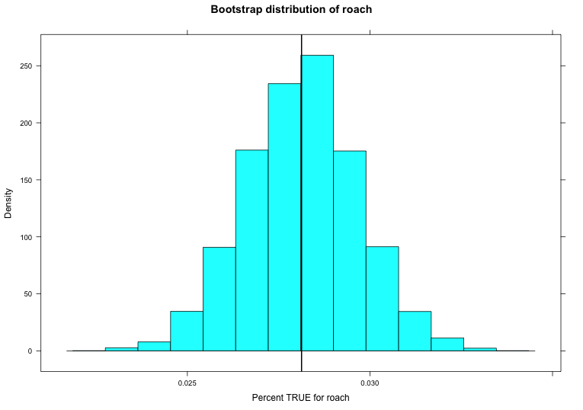
Notes:
Cody

Slide 23
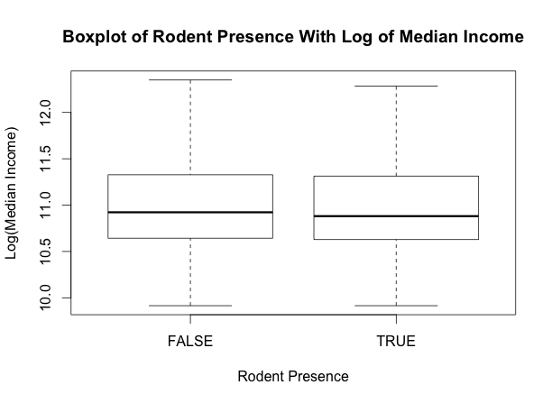
Notes:
Cody

Slide 24
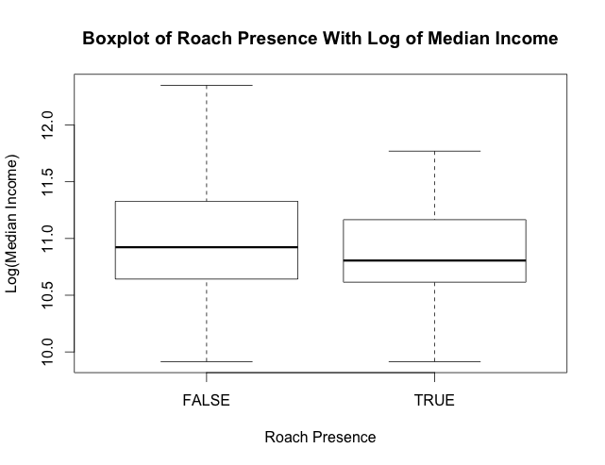
Notes:
Cody

Slide 25
Conclusion
Chinese restaurants are worse than some other cuisines such as American restaurants, but are likely not the worst cuisine
The Significance of Median income disappears when cuisine is included in the model
Rodents and roaches are fairly common (about 10% and 3%, respectively)
Rodents seem independent of income while roaches are less common in more affluent areas
Notes:
The significance of income on score can be explained by the fact that cleaner cuisines, such as American restaurants, are more likely to be opened in higher income zip codes.
Essentially, it looks like income is positively related to score, but what seems to be the case is that income is related to cuisine and cuisine is related to score (i.e. American restaurants tend to be opened in wealthy areas and Latin/Asian restaurants are more likely to be open in lower income areas. There isn’t a significant difference in an Asian restaurant in a high income area vs. a low income area just a difference in Asian and American)

Slide 26

Thank you!

Slide 27
Sources
Background image: http://www.blogrollcenter.com/news/gallery/searching-for-authentic-italian-restaurants/searching_for_authentic_italian_restaurants.jpg
http://www.cleaningservicenewyorkcity.com/fun-facts-about-new-york-city.html

